Slide 1



Slide 2
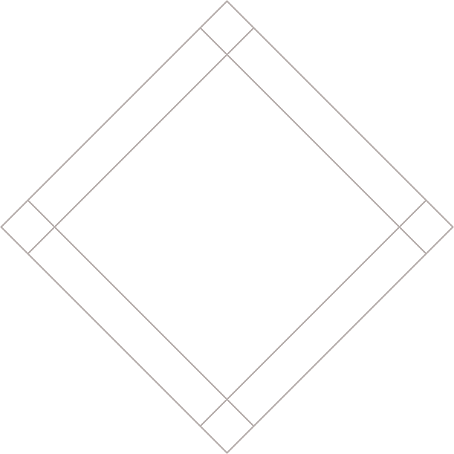


Slide 3



THREE LIST TYPES
ORDERED
UNORDERED
DEFINITION
1. Chop potatoes into quarters
2. Simmer in salted water
3. Heat milk and butter
4. Drain potatoes and mash
5. Mix in the milk mixture
• 1kg King Edward potatoes
• 100ml milk
• 50g salted butter
• Freshly grated nutmeg
• Salt and pepper to taste
Sashimi
Sliced raw fish
Scale
A device used to
accurately measure weight
Notes:
Explain: There are three different types of list...
1. Ordered - The order of list items is important
2. Unordered - The order of list items is not important
3. Definition - To explain the meaning of terms

Slide 4
ORDERED LISTS (numbered)
<ol>
<li>Chop potatoes into quarters</li>
<li>Simmer in salted water for 15-20
minutes until tender</li>
<li>Heat milk, butter and nutmeg</li>
<li>Drain potatoes and mash</li>
<li>Mix in the milk texture</li>
</ol>
Notes:
Explain: What tags stand for:
<ol> = ordered list
<li> = list item
Re-iterate that the sequence of the steps in a recipe is important, therefore we use an ordered list

Slide 5
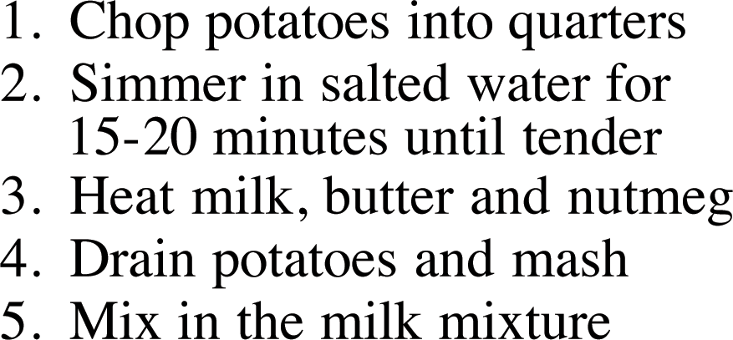

Slide 6
UNORDERED LISTS (bullets)
<ul>
<li>1kg King Edward potatoes</li> <li>100ml milk</li> <li>50g salted butter</li> <li>Freshly grated nutmeg</li> <li>Salt and pepper to taste</li>
</ul>
Notes:
Explain: What tags stand for:
<ul> = unordered list
<li> = list item
Re-iterate that there is not sequence to these items, therefore unordered list

Slide 7
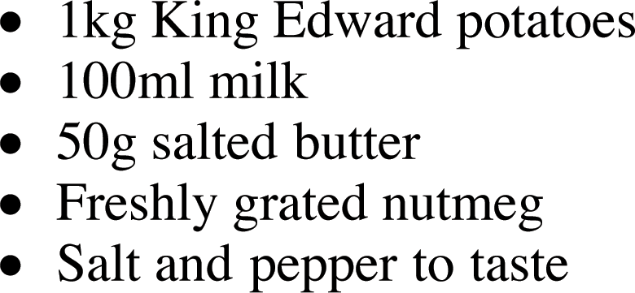

Slide 8
DEFINITION LIST
<dl>
<dt>Sashimi</dt> <dd>Sliced raw fish served
with condiments.</dd> <dt>Scale</dt> <dd>Device used to measure the weight of ingredients.</dd> <dd>A technique by which the scales are
removed from the skin of fish. </dd></dl>
Notes:
Explain: What tags stand for:
<dl> = definition list
<dt> = definition term
<dd> = definition description

Slide 9
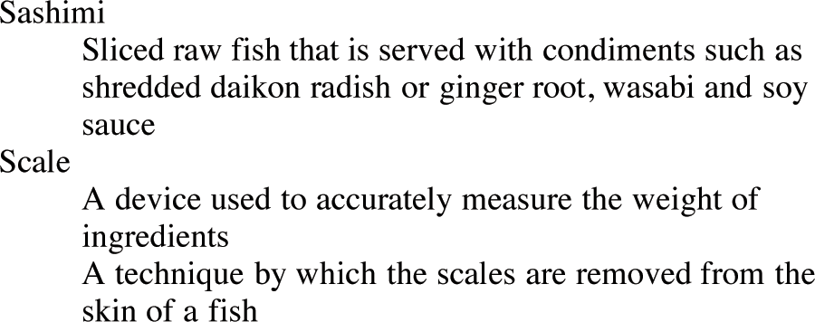

Slide 10
NESTED LIST
<ul>
<li>Mousses</li>
<li>Pastries</li> <ul>
<li>Croissant</li>
<li>Milles-feille</li>
<li>Palmier</li>
<li>Profiteroles</li>
</ul>
<li>Tarts</li>
</ul>
Notes:
Explain how you can nest lists inside other lists
You can do the same for ordered lists to create sub-points

Slide 11
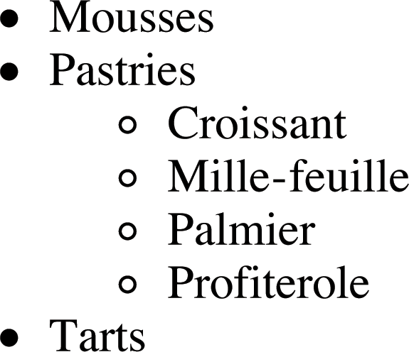

Slide 12
SUMMARY
There are three types of HTML lists: ordered, unordered, and definition.
Notes:
Clicks: Load individual bullets

Slide 13
SUMMARY
Ordered lists use numbers.
Notes:
Clicks: Load individual bullets

Slide 14
SUMMARY
Unordered lists use bullets.
Notes:
Clicks: Load individual bullets

Slide 15
SUMMARY
Definition lists are used to define terminology.
Notes:
Clicks: Load individual bullets

Slide 16
SUMMARY
Lists can be nested inside one another.
Notes:
Clicks: Load individual bullets

Slide 17
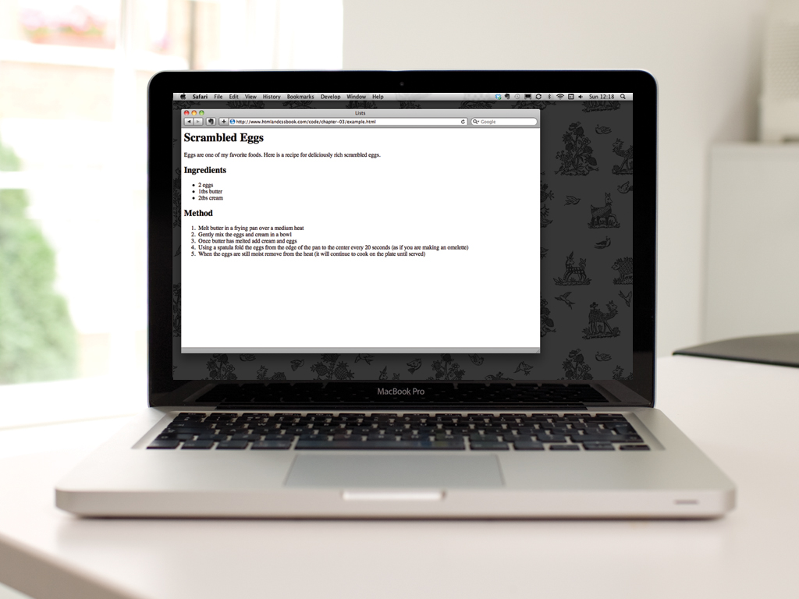

Slide 18


